Slide 1
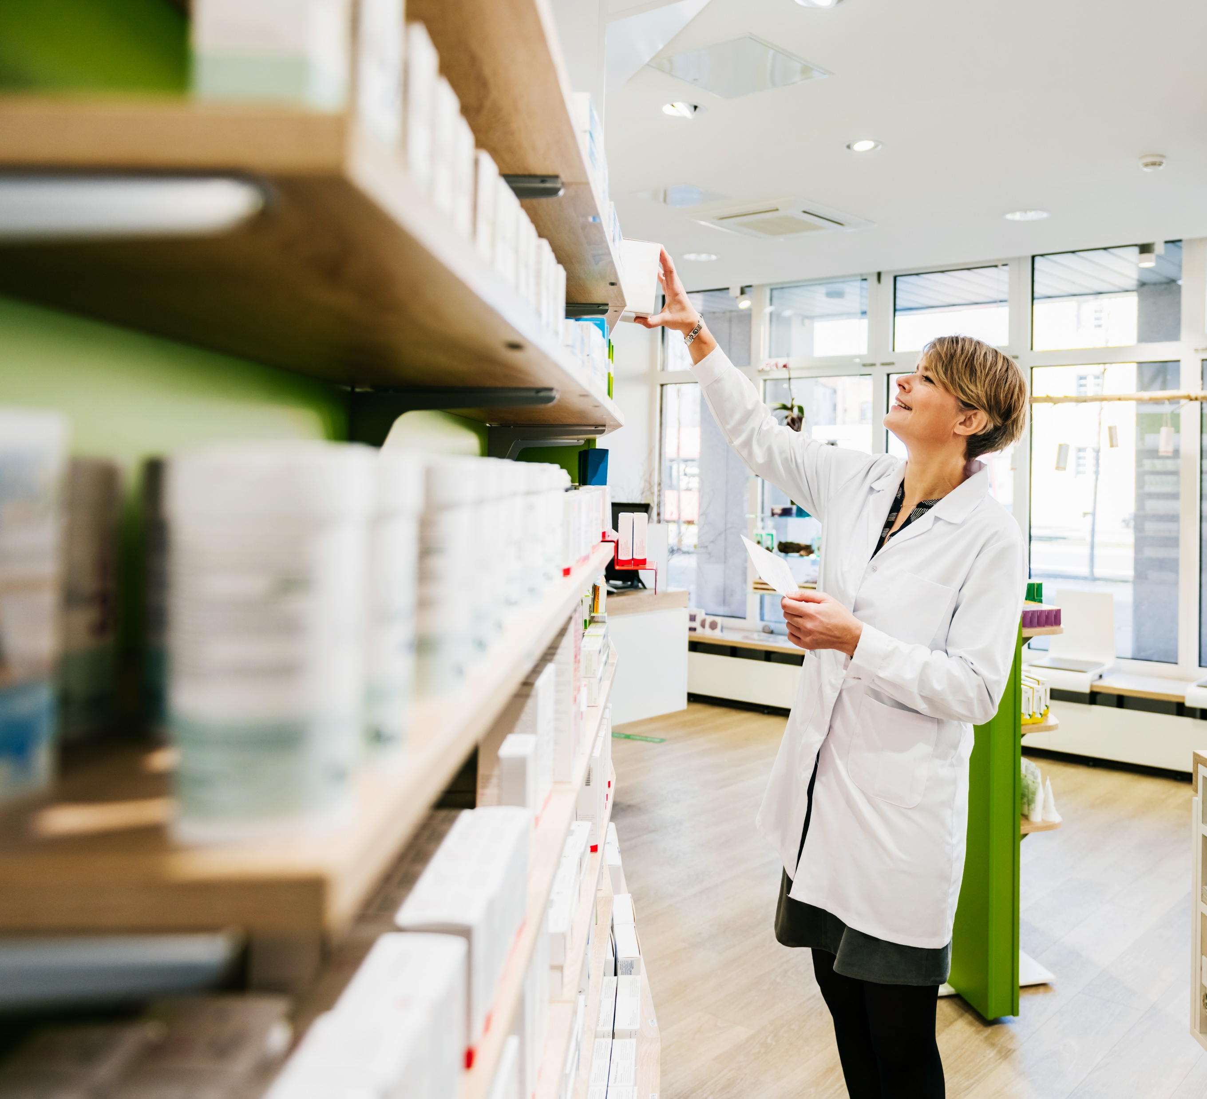
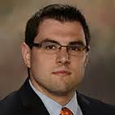
Biosimilars: Key Considerations and Approach to Pharmacy Benefit Management
April 6, 2023
EPBA
Michael Scalese, PharmD, BCCP, BCPS
Director, Clinical Services and Industry Relations at Prescryptive Health

Slide 2
Learning Objectives
Upon completion of the presentation, you will be able to:
Describe a biosimilar and how it works, including identifying the difference between a biosimilar and a generic
Discuss legal and regulatory requirements for biosimilars and how they impact cost optimization and potential therapy interruption
Compare and contrast biosimilar management strategies, including the advantages and disadvantages of each

Slide 3
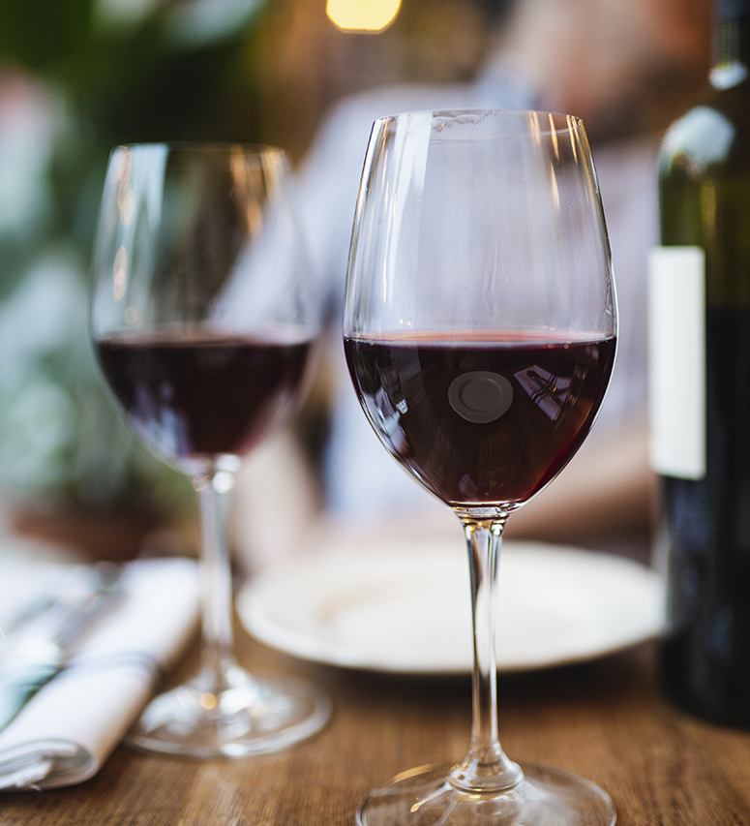
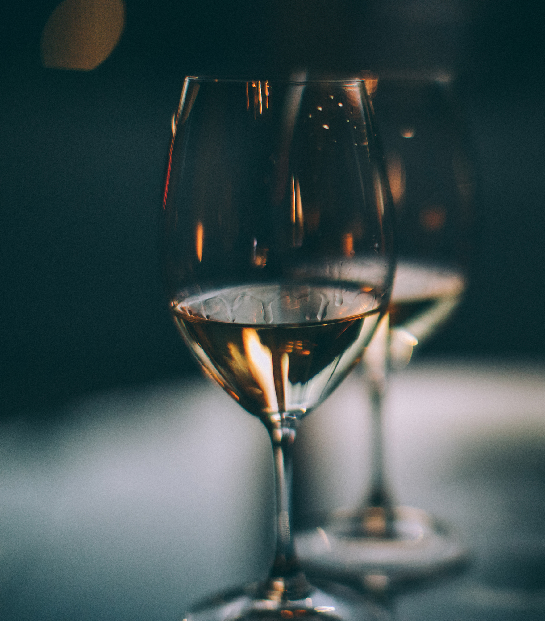

Slide 4
Definitions
Biological product: large, complex molecules made through biotechnology from living sources including bacteria, yeast, or animal cells
Commonly referred to as “biologic”
Reference product: original FDA-approved biologic drug
Biosimilar product: a biologic that is highly similar to, and with no clinically meaningful differences from, an existing FDA-approved biologic/reference product
Small molecule: chemically synthesized non-biologic drugs with low molecular weight

Slide 5
Biosimilar Boom
The U.S. biologics market has grown 12.5% annually on average over the last five years on an invoice-price basis, faster than non-biologics, and now comprising 46% of spending.
Expected launches and uptake are likely to increase overall spending on biosimilars significantly to $20–$49Bn in 2027 and cumulative sales of $129Bn over the next five years, with at least 10 molecules facing biosimilar competition over the period.
The next five years are expected to result in an increase in savings to $181Bn, more than four times savings over the past five years ($40Bn), as newly approved biosimilars launch and existing biosimilars see continued uptake and price reductions.
Source: Biosimilars in the United States 2023-2027 - IQVIA

Slide 6
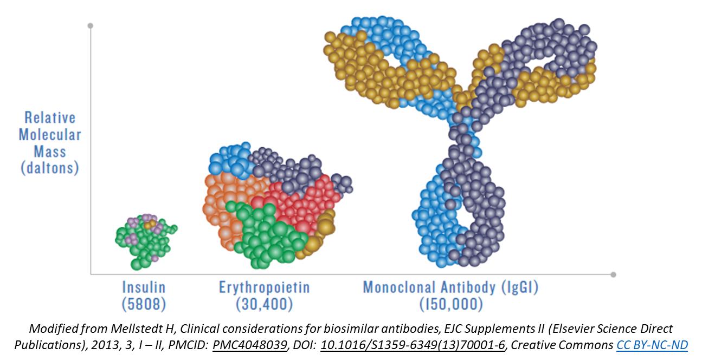
Biologic Products
Composed of a complex combination of sugars, proteins and/or nucleic acids
Include therapeutic proteins, blood products, vaccines, or monoclonal antibodies
Regulated by the FDA under 351(a) pathway
Used to treat to prevent, treat, and cure a variety of conditions including:
Inflammatory bowel diseases
Arthritis
Psoriasis
Cancer
Allergic/immunologic conditions
U.S. Food & Drug Administration. Biosimilars Info Sheet. Level 1: Foundational Concepts: Biological Products, Biosimilar Products, and Interchangeable Biosimilar Products.[cited 2/17/2023]. Available at: Biological Products, Biosimilar Products, and Interchangeable Biosimilar Products (fda.gov).

Slide 7
Biologic Product Development
Commonly produced via recombinant DNA technology in a living system
Complicated to characterize in comparison to small molecule drugs
Have slight inherent variations within manufacturing process
From lot to lot and within lots
Range in size and complexity
Part of FDA approval involves review of strategy to control for variations to ensure consistent safety and efficacy
Biologic products are produced entirely or in part within a biological system including bacterial, viral, fungal, and even mammalian cells
U.S. Food & Drug Administration. Level 1: Biosimilar and Interchangeable Products Foundational Concepts. [cited 2/17/2023]. Level 1_Slides_Foundational Concepts_v3.pptx (live.com).

Slide 8
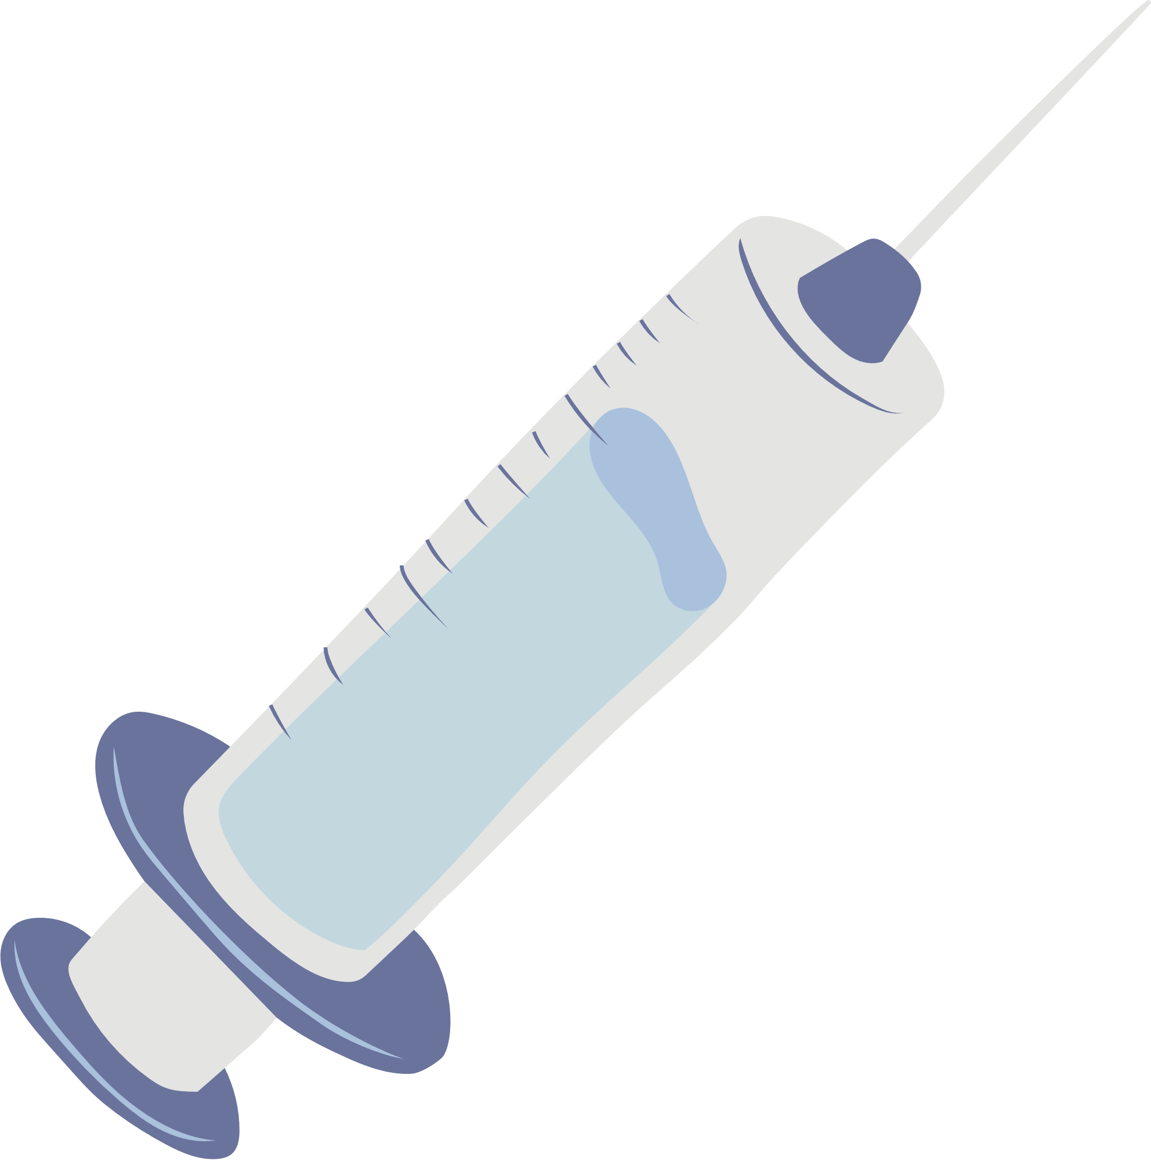
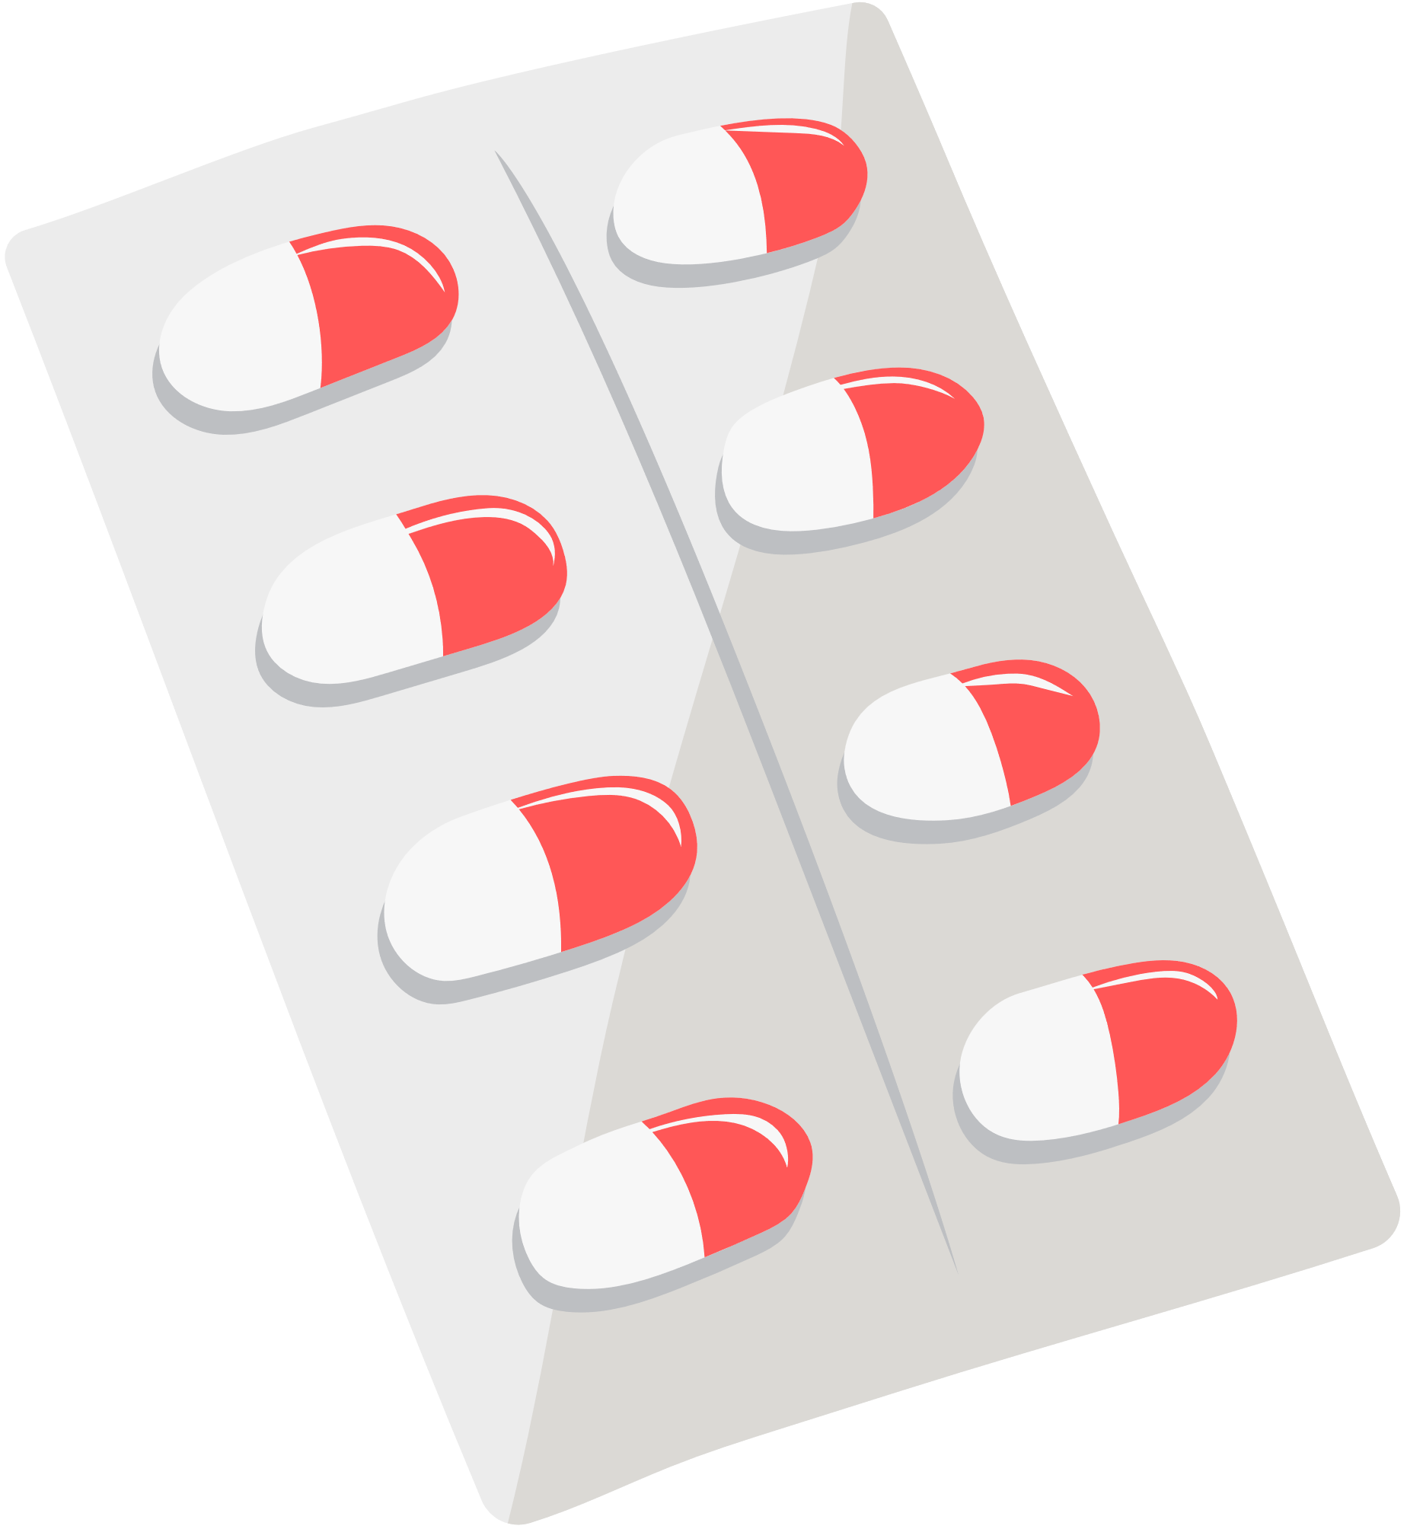
Biosimilar Products
A biological product that is highly similar and with no clinically meaningful differences when compared to its approved reference product in safety, purity, or potency
Regulated by the FDA under 351(k) pathway
Offer cost-savings benefit to patient, payer, and system through improved access, availability and competition
Same
administration
Same
type of source
Same strength
Same dose
Same treatment effects
Same adverse effects
U.S. Food & Drug Administration. Level 1: Biosimilar and Interchangeable Products Foundational Concepts. [cited 2/17/2023]. Level 1_Slides_Foundational Concepts_v3.pptx (live.com).

Slide 9
Biosimilar vs. Generic Products
 | Generic | Biosimilar
Manufacturing | Chemically synthesized | Derived from living sources
Molecular entity | Small and simple | Large and complex
Active ingredient | Identical between lots and to brand name drug | Inherently variable (small variation in protein molecules)
Reproducibility | Easy to establish | Difficult to establish
Approval | Must demonstrate active ingredient is the same as reference drug | Must demonstrate highly similar with only minor differences in inactive ingredients
 | Must demonstrate bioequivalence to reference drug | Must demonstrate no clinically meaningful difference from reference product
U.S. Food & Drug Administration. Level 1: Biosimilar and Interchangeable Products Foundational Concepts. [cited 2/17/2023]. Level 1_Slides_Foundational Concepts_v3.pptx (live.com).

Slide 10
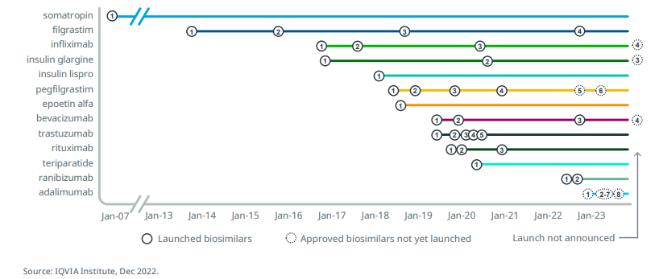
Since 2007, 30 biosimilars have launched in the U.S. with 10 more approved and set to launch by the end of 2023

Slide 11
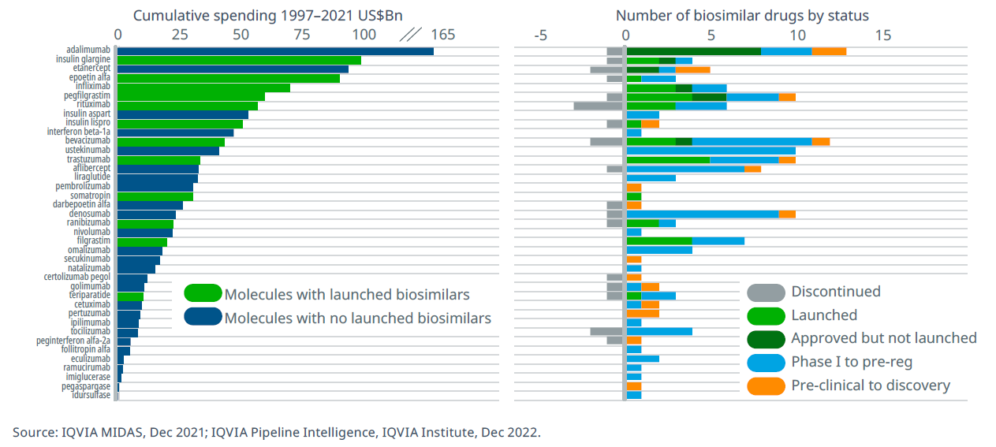
There are biosimilars in clinical development in the U.S. for 20 additional molecules

Slide 12
Biosimilar Pipeline 2023
Estimated Approval
AVT04 – Alotech, Teva
Stelara (Ustekinumab) Biosim
Adalimumab-atto
Amjevita
2023
JAN
FEB
MAR
APR
MAY
JUN
JUL
AUG
SEP
OCT
NOV
DEC
Predicted Launch July 2023 or after
Adalimumab-bwwd - Hadlima
Adalimumab-adbm - Cyltelzo* (Interchangeble)
Adalimumab-afzb - Abrilada
Adalimumab-aqvh - Yusimry
Adalimumab-fkjp - Hulio
Adalimumab-aacf – Idacio
Adalimumab-adaz - Hyrimoz
Biosimilar Launch
Biosimilar Predicted Launch
IPD Analytics. Drug Management: Biosimilar Medications. Clinical Snapshot. Online database [cited 2/17/2023]. Available at: Drug Management: Biosimilar Medications (ipdanalytics.com)

Slide 13
Biosimilar Outlook 2023 and Beyond
Biosimilar | Status | Estimated Approval
Stelara (ustekinumab)
ABP 654 (Amgen) | Pending Approval | Q3/Q4 2023
CT-P43 (Celltrion) | Phase 3 | 2023-2024
SB17 (Samsung Bioepis) | Phase 3 | 2023-2024
Bmab1200 (Biocon) | Phase 3 | 2023-2024
Actemra (tocilizumab)
MSB11456 (Fresenius) | Pending Approval | Q2 2023
BIIB800/BAT1806 (Biogen, Bio-Thera) | Pending Approval | October 2023
Prolia (denosumab)
9 Biosimilars Pending | Phase 3 | Estimated Launch: 2025
Cimzia (certolizumab pegol)
BIIB801 (Biogen) | Preclinical | 2027+
IPD Analytics. Drug Management: Biosimilar Medications. Clinical Snapshot. Online database [cited 2/17/2023]. Available at: Drug Management: Biosimilar Medications (ipdanalytics.com)

Slide 14
Biosimilar Requirements

Slide 15
Reference Biologic Development Timeline & Cost
Discovery
Development
Preclinical
Phase 1
Phase 2
Phase 3
Biologics Price Competition and Innovation Act
(BPCIA, 2009)
Est total cost > $1Bn
Development
Preclinical
Phase 1
Phase 3
Biosimilar Development Timeline & Cost
Est total cost $100-200M
Part of the Affordable Care Act (ACA)
Created abbreviated licensure pathway for products demonstrated to be biosimilar to FDA-approved biologics
Increased access to medications
More treatment options available
Lower healthcare costs
U.S. Food & Drug Administration. Biosimilars Info Sheet. Level 1: Foundational Concepts: Biological Products, Biosimilar Products, and Interchangeable Biosimilar Products.[cited 2/17/2023]. Available at: Biological Products, Biosimilar Products, and Interchangeable Biosimilar Products (fda.gov).

Slide 16
Analytical Data
Foundation of approval process
Characterize reference product quality features and product variability
Based on comparative data from
Physicochemical assays
Functional assays
Analytical data demonstrates that proposed biosimilar is highly similar to the reference product
U.S. Food and Drug Administration. Overview of the Regulatory Framework and FDA’s Guidance for the Development and Approval of Biosimilar and Interchangeable Products in the US.[cited 2/17/2023]. Available at: https://www.fda.gov/media/109573/download.

Slide 17
Pre-Clinical Data
Animal toxicity data used when uncertainties remain about safety
Completed prior to initiating clinical studies
Depends on publicly available information/data and comparison between biosimilar and reference products
May include comparison of PK/PD in animal models
Animal studies provide pharmacology information for the biosimilar as necessary
U.S. Food and Drug Administration. Overview of the Regulatory Framework and FDA’s Guidance for the Development and Approval of Biosimilar and Interchangeable Products in the US.[cited 2/17/2023]. Available at: https://www.fda.gov/media/109573/download.

Slide 18
Clinical Data: Residual Uncertainty
Biosimilar Approval Concept
The nature and scope of clinical studies depends on degree of residual uncertainty after conducting structural, functional, and animal studies
U.S. Food and Drug Administration. Overview of the Regulatory Framework and FDA’s Guidance for the Development and Approval of Biosimilar and Interchangeable Products in the US.[cited 2/17/2023]. Available at: https://www.fda.gov/media/109573/download.

Slide 19
Clinical Data Requirement
Adequate clinical PK and PD comparisons
At least 1 clinical study compares immunogenicity
Comparative clinical study required if residual uncertainties exist regarding if there are clinically meaningful differences between products
Population, endpoint, sample size and study duration should be adequately sensitive to detect differences
Assess safety and immunogenicity
Clinical data demonstrate that there are no clinically meaningful differences in safety, purity, and potency.
U.S. Food and Drug Administration. Overview of the Regulatory Framework and FDA’s Guidance for the Development and Approval of Biosimilar and Interchangeable Products in the US.[cited 2/17/2023]. Available at: https://www.fda.gov/media/109573/download.

Slide 20
Extrapolation
Biosimilar Approval Concept
FDA may approve for indication or population without direct studies with adequate justification based on extrapolation, considering:
All available data and information in application
FDA’s previous finding of safety and efficacy for other approved indications
Knowledge of scientific factors
U.S. Food and Drug Administration. Overview of the Regulatory Framework and FDA’s Guidance for the Development and Approval of Biosimilar and Interchangeable Products in the US.[cited 2/17/2023]. Available at: https://www.fda.gov/media/109573/download.

Slide 21
Interchangeability
An interchangeable product is a biosimilar that meets additional requirements
Produces the same clinical results in any given patient
Switching between the products will not reduce efficacy or increase toxicity
May be substituted for the reference product without direct involvement of the provider
U.S. Food & Drug Administration. Level 1: Biosimilar and Interchangeable Products Foundational Concepts. [cited 2/17/2023]. Level 1_Slides_Foundational Concepts_v3.pptx (live.com).

Slide 22
Interchangeable Biosimilars
Interchangeability may offer added assurance but otherwise is a legal designation, not a clinical one
Four FDA approved interchangeable biosimilars
Semglee (insulin glargine-yfgn)
Rezvoglar (insulin glargine-aglr)
Cimerli (ranibizumab-eqrn)
Cyltezo (adalimumab-adbm) – not yet launched
Not all have completed switching studies
November 2019 FDA draft guidance states a switching study may not be necessary for IC designation, if highly similar with very low residual uncertainty about immunogenicity
IPD Analytics. Rx Insights: Drug Management. Primer on Biosimilars and Interchangeability. [cited 2/17/2023]. Available at: Drug Management: Primer on Biosimilars and Interchangeability (10/24/22)

Slide 23
Interchangeability Outlook
Biologic/Biosimilar | Status | Estimated Approval/Launch
Insulin
Humalog (insulin lispro) Biosimilar | Seeking IC Status | 2024+
Lantus (insulin glargine) Biosimilar (at least 2) | Seeking IC Status | 2023 +
Novolog (insulin aspart) Biosimilar (at least 3) | Seeking IC status | 2022-2023
Non-Insulin Biologics
Remicade (infliximab) Biosimilar | Seeking IC Status | 2024+
Simponia Aria (golimumab) Biosimilar | Seeking IC Status | 2024+
Stelara (ustekinumab) | Seeking IC Status | 2023+
Humira (adalimumab) 50 mg/mL Biosimilar (at least 2) | Approved, pending launch | 2023+
Adalimumab (Humira) 100 mg/mL Biosimilar (at least 3) | Seeking IC status, pending launch | 2023-2024+
IPD Analytics. Rx Insights: Drug Management. Primer on Biosimilars and Interchangeability. [cited 2/17/2023]. Available at: Drug Management: Primer on Biosimilars and Interchangeability (10/24/22)

Slide 24
Exceptions and Exclusions: Orphan Drug Status
Orphan drug status incentivizes drug development for rare diseases through tax credits and exclusivity after approval
A single orphan drug designation delays potential entry of biosimilar product for all indications
Biosimilar applicant requests approval for specific indications for which the reference biologic is approved if others are protected by exclusivity
FDA can approve biosimilar “skinny label” to carve out indications protected by patent exclusivities to allow for timely market competition
Ward E, Steinbrook R. Savings Associated With "Skinny Label" Biosimilars. JAMA Intern Med 2023;183(1):84.
National Organization for Rare Diseases (NORD). Orphan Drugs in the United States: An Examination of Patents and Orphan Drug Exclusivity. [cited 2/17/2023]. Available at: NORD-Avalere-Report-2021_FNL-1.pdf (rarediseases.org).

Slide 25
Biosimilar Naming
adalimumab-atto (Amjevita)
non-proprietary 4-letter biosimilar
core name suffix brand
Combination of nonproprietary core name PLUS unique 4-letter suffix
Same core name as reference product
Suffix to distinguish products
Adopted for pharmacovigilance and medication safety
U.S. Food & Drug Administration. Biosimilar and Interchangeable Products. Level 2: Regulatory and Scientific Concepts. [cited 2/17/2023]. Level 2_Slides_Regulatory and Scientific Concepts_v4.pptx (live.com).

Slide 26
The Path to Biosimilar Approval and Launch

Slide 27
Biosimilar Launch Timeline
Biosimilar applicant develops and tests biosimilar
Biosimilar applicant files 351(k) BLA
BCPIA Litigation (2nd wave)
Litigation resolved
At least 12 years
1
2
3
Oct
5
6
7
8
9
10
11
12
13
4
At least 4 years
Reference product (RP) sponsor develops and tests reference biologic
RP
sponsor patents drug
RP sponsor files 351(a) BLA
FDA approves 351(a) BLA
BCPIA Litigation (1st wave)
FDA approves 351(k) BLA
RP
sponsor patents expire
(may expire earlier or later)
“Patent Dance”
Biosimilar applicant provides 180 day pre-market notice
Path from “Patent Dance” to 1st wave of BCPIA litigation
~240 days
Reference product sponsor actions
Biosimilar applicant actions
Both reference product and biosimilar sponsor actions
BCPIA: Biologics Price Competition and Innovation Act
Biosimilar enters market

Slide 28
Biosimilar “Patent Dance”
Parties agree on patent list
RP sponsor gives patent list
RP sponsor gives contentions
7g(1)
30 days
20 days
60 days
60 days
60 days
15 days
7a
7b
7c
7d
7e
7f
7g
RP sponsor files complaint
7i
8
Oct
10
11
13
15 days
BCPIA Litigation (1st wave)
Biosimilar applicant files 351(k) BLA
FDA accepts 351(k) BLA for review
Biosimilar applicant gives RP sponsor 351(k) BLA
Biosimilar applicant gives patent list and contentions
7g (1)
7g (2)
7g(3)
Parties negotiate patent list
No agreement on patent list
5 days
30 days
Parties exchange patent list
Biosimilar applicant discloses number of patents
Reference product sponsor actions
Biosimilar applicant actions
Both reference product and biosimilar sponsor actions
BCPIA: Biologics Price Competition and Innovation Act

Slide 29
Biosimilar Pharmacy Benefit Management

Slide 30
Strategy “Menu” at a Glance
Reference Product Role
Biosimilar Selection
Biosimilar Buy-In

Slide 31
Reference Product Considerations

Slide 32
Portfolio Contracting
Rebates
Customer Loyalty
Patent Pursuits
Supply Chain Differentiation
Defense Strategies

Slide 33
Reference Product Considerations
Direct competitor with biosimilars
Interchangeability exception
“Clinical” inertia driven desire for continued use
May have patent-protected indications biosimilars do not
Manufacturer pricing dictates market share
Would it be better to stick with the reference product?

Slide 34
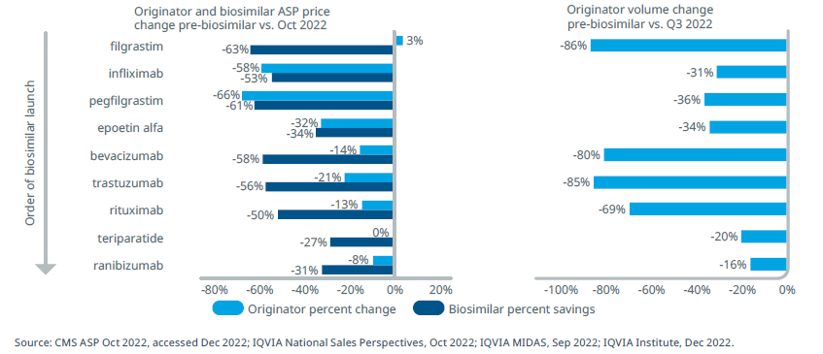
Reference product price is directly related to biosimilar usage. Higher prices result in higher volume lost

Slide 35
Reference Product Bottom Line
Reference product may offer short term benefits
Better buy-in from patients and prescribers
Cost still lower than before biosimilar competition (but more than a biosimilar)
Short term benefits mitigated by long-term effect
Disincentivizes biosimilar development
Loss of future competition & overall higher cost
Formulary placement can drive population utilization
Biosimilar in a preferred position
Barriers to reference product access

Slide 36
Biosimilar Product Selection Considerations

Slide 37
Biosimilar Product Selection Process
Clinical Review
Patient populations
Financial Review
Net drug cost
Formulary Considerations
Preferred vs non-preferred
FDA-approved indications
Trial data/guideline recommendations
Provider input
Prior authorizations
Step-therapy
Grandfathering
Rebates
Manufacturer list pricing

Slide 38
Supply Chain and Distribution
Biologics & biosimilars have a complicated manufacturing process
More complex than generic drugs
Less competition
Individual manufacturer supply volume capabilities
Product availability at specific pharmacies
Important for outpatient self-administered products
Including more than 1 biosimilar on formulary may be beneficial
Lower risk of supply chain and access issues

Slide 39
Product Formulation
Biologics and thus biosimilars may have multiple strengths and formulations
Device patent longevity
Device does not lose patent along with drug
May have alternate storage and administration techniques
Concentration differences
Preservative differences
Ex: Adalimumab with or without citrate

Slide 40
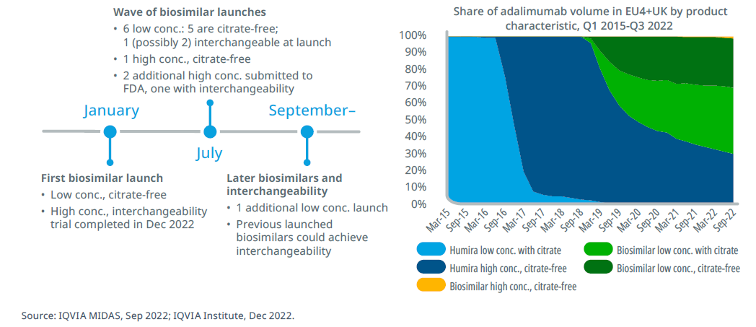
Adalimumab Case Study

Slide 41
Interchangeability
Automatic substitution but with varying requirements
Products can be substituted by a pharmacist at time of prescription fulfillment
Change must be reported to prescriber
Reporting requirements vary state-to-state
Washington state requires notice within 5 business days (HB2251)
Potential benefits may impact desirability
Smoother billing and filling Rx on the front end
Lower likelihood of prescriber pushback
May improve biosimilar uptake in the market

Slide 42
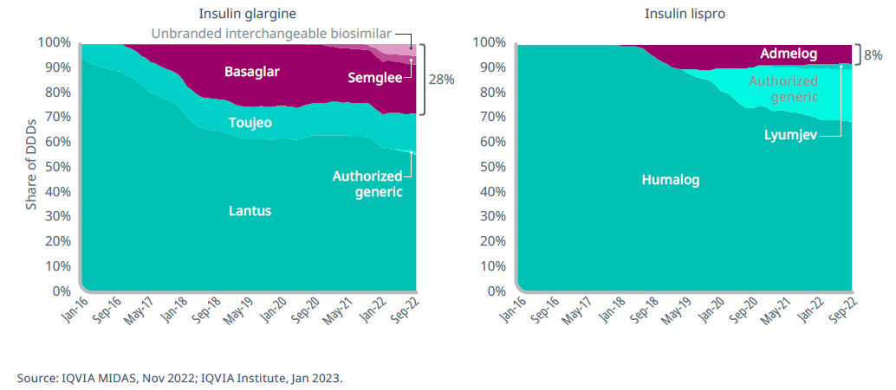
Interchangeability has increased biosimilar use where biosimilar uptake has remained low due to originator defense strategies

Slide 43
Manufacturer Pricing Strategies
High Cost, High Rebate
Advantages
Contribution to rebate guarantees
Disadvantages
Delayed cash flow
Unknown how much payer reaps
Low Cost, Low Rebate
Advantages
Lower initial outlay
Disadvantages
Lower contribution to rebate guarantees

Slide 44
Formulary Management
Moving brand to deprioritized/not covered status
Easy application to new-start patients
Addressing existing patients
Grandfathering hurts value proposition
Addressing patent-protected indications
Flexible PA requirements and application to therapeutic class

Slide 45
Biosimilar Buy-In

Slide 46
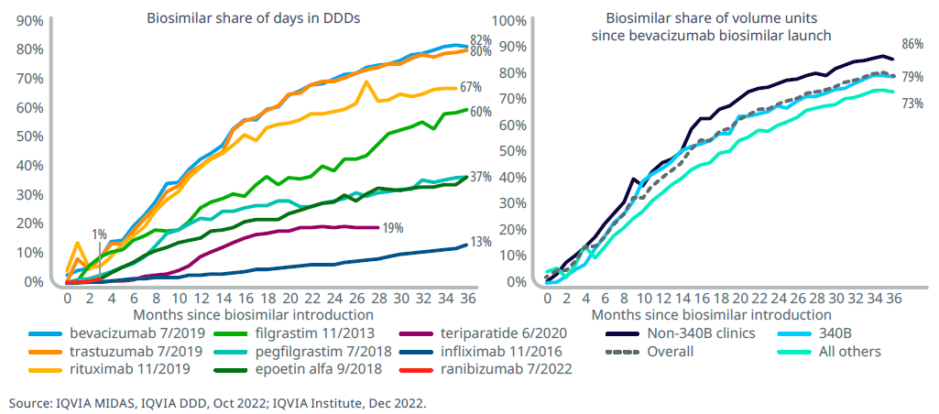
Recent biosimilars have achieved high volume shares, reaching more than 60% within the first three years, varying by channel

Slide 47
Factors Impacting Biosimilar Uptake
Network Access
Product distribution & reimbursement
Payer-Implemented Restrictions
Required step therapy
Prior authorizations & other UM programs
Product Characteristics
Inactive ingredients & available concentrations
Administration considerations
Practice Setting
Patient & Provider Education
Institutional vs Outpatient
Medically vs self-administered
Confidence in biosimilars

Slide 48
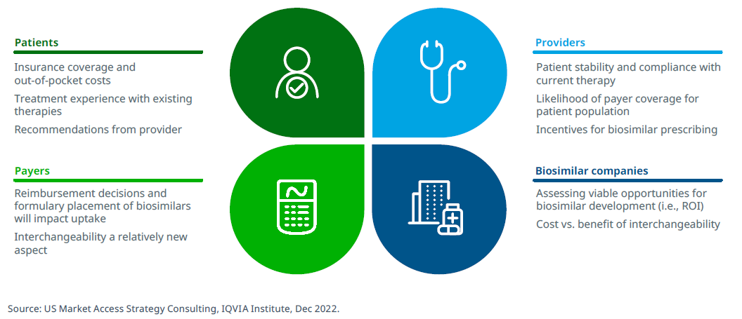
Future direction of biosimilars is multifactorial

Slide 49
Key takeaways
Although different than generics in development and regulatory requirements, biosimilars can result in savings up to $181Bn over the next 5 years
With proven clinical similarity to the reference product, the choice of which biosimilar(s) to preferentially include is multifactorial and creates significant contracting opportunities
Optimization of biosimilar implementation will require the education of, and buy-in from, patients, providers, and payers
Regardless of strategy, incorporation of biosimilars into practice is crucial to foster continued development of new biosimilar products and reduced cost to all stakeholders

Slide 50
Which of the following is true regarding biosimilars?
Biosimilars are the same as generic drugs
Biosimilars are only applicable to small molecule drugs
Biosimilars follow the same approval pathway as biologic reference products
Biosimilars have no meaningful difference even if not designated as interchangeable
All of the above
Self Assessment Question

Slide 51
OPEN DISCUSSION: Questions?

Slide 52
Stay in touch
Michael Scalese, PharmD, BCCP, BCPS
Director, Clinical Services and Industry Relations at Prescryptive Health
Email: michael.scalese@prescryptive.com
Phone (cell): (717) 645-3428
prescryptive.com
facebook.com/ prescryptive
@prescryptiveH
linkedin.com/company/prescryptive

